Slide 1
Department of MCA
Advanced Programming– 21MCA3041
Module 3: Delegates, Events, Exception Handling and ADO.NET
Programming
Handling By
Nirupama K
Asst. Prof. Dept. of MCA

Slide 2
Delegates
Delegates is a special type of object that contains the details of a method rather than data
Delegate is a class type object which is used to invoke a method that has been encapsulated into it at the time of its creation
Delegates can be used to hold the reference to a method of any class
Creating and using delegates
Declaring delegate
Defining delegate method
Creating delegate object
Invoking delegate object
Declaring delegate
[access modifier] delegate return-type delegate-name (parameters-list);
public delegate int MyDelegate (string s);

Slide 3
Defining delegate method
static void MethodA(string message)
{
Console.WriteLine("Called ClassA.MethodA() with parameter: " + message);
}
Creating delegate object
delegate-name Object-name = new delegate-name(expression)
Invoking Delegate
Delegate-object(arguments-list)
Multicaste Delegates
So far we have seen delegate object that have created to hold reference of single method
We can also invoke multiple delegate that is known as multicaste delegate

Slide 4
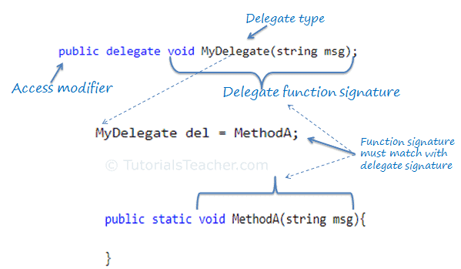

Slide 5
Event
Events are user actions such as key press, clicks, mouse movements, etc., or some occurrence such as system generated notifications.
Applications need to respond to events when they occur. For example, interrupts. Events are used for inter-process communication.
The events are declared and raised in a class and associated with the event handlers using delegates within the same class or some other class
An event is a notification sent by an object to signal the occurrence of an action. Events in .NET follow the observer design pattern.
Syntax of event
access modifier event-type event-name;
Class-object.event-name += new class-object .delegate-name(method-name);
Class-object.event-name -= new class-object .delegate-name(method-name);
this.MyEvent += new MyDel(this.WelcomeUser);

Slide 6
Exception handling
An exception is a problem that arises during the execution of a program. A C# exception is a response to an exceptional circumstance that arises while a program is running, such as an attempt to divide by zero.
Exceptions provide a way to transfer control from one part of a program to another. C# exception handling is built upon four keywords: try, catch, finally, and throw.
try − A try block identifies a block of code for which particular exceptions is activated. It is followed by one or more catch blocks.
catch − A program catches an exception with an exception handler at the place in a program where you want to handle the problem. The catch keyword indicates the catching of an exception.
finally − The finally block is used to execute a given set of statements, whether an exception is thrown or not thrown. For example, if you open a file, it must be closed whether an exception is raised or not.
throw − A program throws an exception when a problem shows up. This is done using a throw keyword.

Slide 7
Control flow statement
if (i > 0)
Console.WriteLine("The number {0} is positive", i);
//if-then-else selection
if (i > 0)
Console.WriteLine("The number {0} is positive", i);
else
Console.WriteLine("The number {0} is not positive", i);
//multicase selection
if (i == 0)
Console.WriteLine("The number is zero");
else if (i > 0)
Console.WriteLine("The number {0} is positive", i);
else
Console.WriteLine("The number {0} is negative", i);

Slide 8
switch (strVal1)
{ case "reason1":
goto case "reason2"; // this is a jump to mimic fall-through
case "reason2":
intOption = 2;
break;
case "reason 3":
intOption = 3;
break;
case "reason 4":
intOption = 4;
break;
default:
intOption = 9;
break;
}

Slide 9
//find out the number of digits in a given number
int i = 123;
int count = 0;
int n = i;
//while loop may execute zero times
while (i > 0)
{
++count;
i = i / 10;
}
Console.WriteLine("Number {0} contains {1} digits.", n, count);

Slide 10
//find out the number of digits in a given number
int i = 0;
int count = 0;
int n = i;
do
{
++count;
i = i / 10;
} while (i > 0);
Console.WriteLine("Number {0} contains {1} digits.", n, count);

Slide 11
//For loop with break and continue statements
for (int i = 0; i < 20; ++i)
{
if (i == 10)
break;
if (i == 5)
continue;
Console.WriteLine(i);
}
//foreach loop
string[] a = { "Chirag", "Bhargav", "Tejas" };
foreach (string b in a)
Console.WriteLine(b);

Slide 12
For each
Syntax:
foreach(data_type var_name in collection_variable)
{
// statements to be executed
}
It is necessary to enclose the statements of foreach loop in curly braces {}.
Instead of declaring and initializing a loop counter variable, you declare a variable that is the same type as the base type of the array, followed by a colon, which is then followed by the array name.
In the loop body, you can use the loop variable you created rather than using an indexed array element.
string[] cars = {"Volvo", "BMW", "Ford", "Mazda"};
foreach (string i in cars)
{
Console.WriteLine(i);
}

Slide 13
Understanding of ADO .Net
ADO .Net is the data access and manipulation protocol used by C#
It is a disconnected architecture
ADO.NET leverages the power of XML to provide disconnected access to data. ADO.NET is made of a set of classes that are used for connecting to a database, providing access to relational data, XML, and application data, and retrieving results.
Disconnected architecture refers to the mode of architecture in Ado.net where the connectivity between the database and application is not maintained for the full time.
ADO .Net provides set of components to create distributed applications
ADO .Net classes found in System.Data.dll
LINQ to DataSet- LINQ to SQL-
Connection, dataadapter object
Dataset object
Datatable object
A DataAdapter is used to retrieve data from a data source and populate tables within a DataSet.

Slide 14
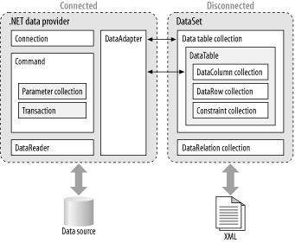
Use the CommandText method to assign a SQL statement to the command and then execute the SQL by calling the ExecuteNonQuery method.

Slide 15
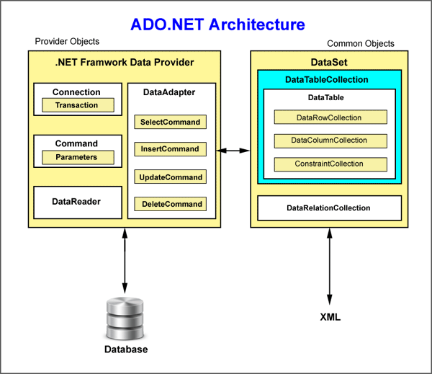
Describing the architecture of ADO .Net

Slide 16
Object of Data Provider
Connection
Command
DataReader
DataAdapter
Data Provider in ADO .Net
.Net Framewor Data Provider for SQL server
.Net Framewor Data Provider for OLE DB
.Net Framewor Data Provider for ODBC
.Net Framewor Data Provider for Oracle
Components of Data set
Data Table
Data View
Data Column
Data Row
Data Relation

Slide 17
Creating connection strings
Data Source=C:\Users\Sai\Documents\Lab2.sdf
Syntax: connetionString="Data Source=ServerName;Initial Catalog=Databasename;
User ID=UserName;Password=Password“
Data Source=.\SQLEXPRESS;AttachDbFilename=C:\Users\Sai\Documents\Lab1.mdf;Integrated Security=True;Connect Timeout=30;User Instance=True

Slide 18
Creating a command object
SqlDataAdapter SDA = new SqlDataAdapter("insert into Course(course_id,course_name) values ('" +textBoxcid.Text + "','" + textBoxcn.Text + "')", con);
Working with Data Adapter
The Data Adapter is the interface between the Data Set and the database itself
Means data adapter is responsible for reading data from database
. OLE DB Data Adapter
. ODBC Data Adapter
. SQL Data Adapter
. Oracle Data Adapter
Creating dataset from data adapter
Updating with data adapter
Creating data view

Slide 19
